Slide 1
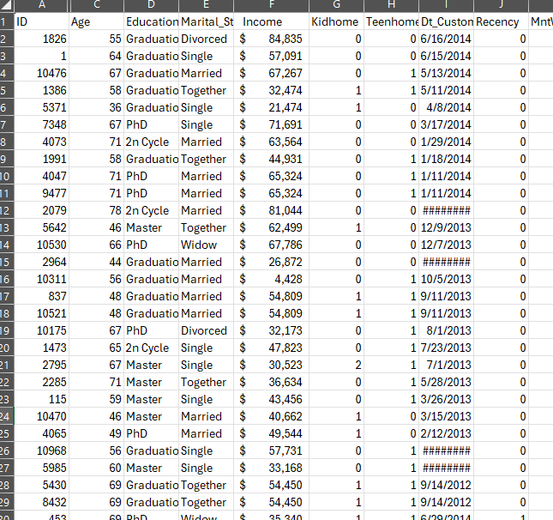




Introduction
Dataset: contains marketing campaign data of 2,240 customers of Maven Marketing
Goal: provide recommendations on how to grow digital revenue and boost online conversions by analyzing:
  Key customer group(s)
  Channel performance
  Product categories

Slide 2


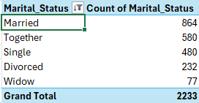
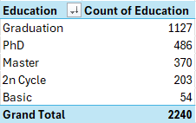
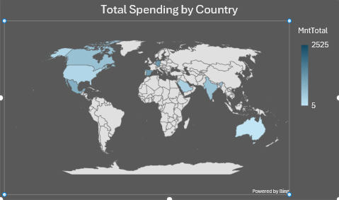
What does the average Maven customer look like?
In mid-50s
Married
Graduate
Often has children/teens at home
Top geographies: Spain, Saudi and Canada

Slide 3
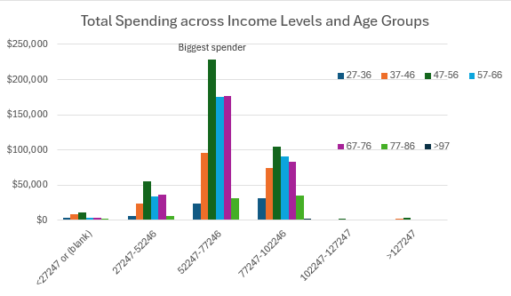
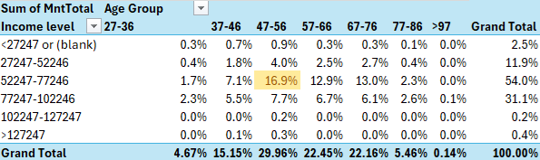
Core customer group
In fact, this single group generates 16.9% of Maven’s total revenue
This key segment
  Earns income of 52-77k
  Age 47-56
  Prioritize marketing efforts, crucial growth driver
Fig.1 Crosstabs analysis of revenue streams

Slide 4
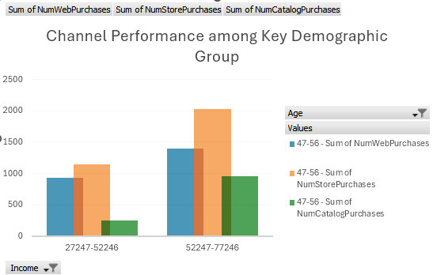
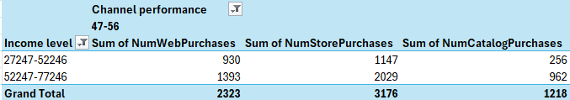
Which channels are most salient to this group?
In-store and Web purchases outperform
Next we’ll take a deep dive into web purchases in our dataset…
Fig2. PivotChart and PivotTable channel analysis

Slide 5
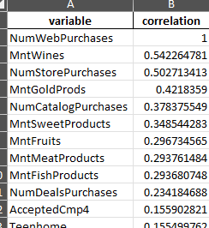
What factors are good predictors of web purchases?
Two positive correlations
  Number of store purchases
    Cross-channel buyers (coef ≈ +0.0420, p < 0.001)
  Spend on wines
    Higher wine spend is associated with more web purchases. (coefficient ≈ +0.0006, p < 0.001)
One negative correlation
  Number of catalog purchases (coef ≈ −0.0155, p ≈ 0.003)
    More catalog purchases are slightly associated with fewer web purchases. Suggesting the catalog channel underperforms for driving web purchases.
Fig3. Poisson regression using Python add-in

Slide 6

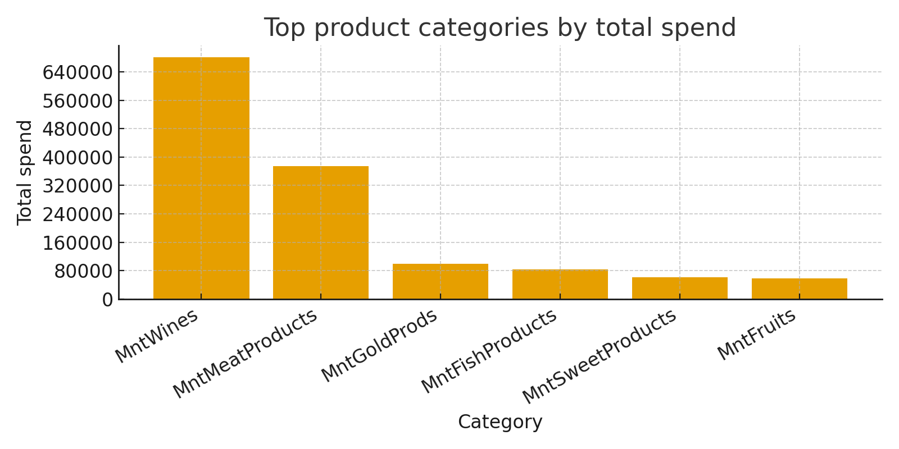
Which products are performing best?
Wine and Meat are the highest-revenue categories
Wine also strongly predicts increased web purchases, so it’s a strategic priority for web promotions and cross-sell.

Slide 7
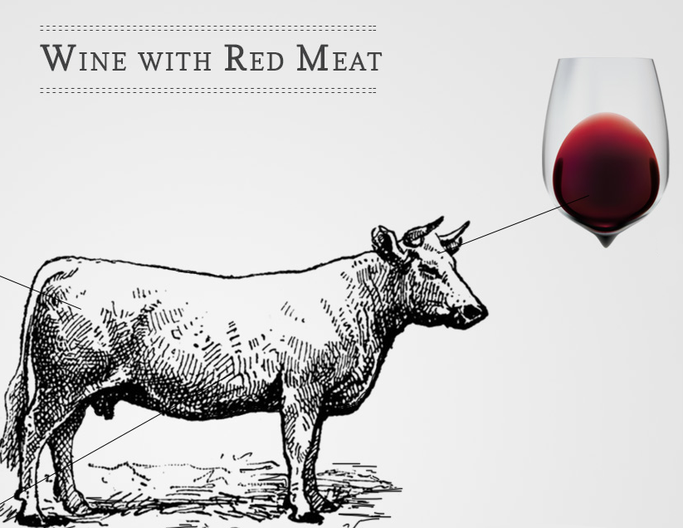

Actionable recommendations
Double down on wine-focused online promotions.
  🍷Wines are the top revenue driver and strongly predict web purchases — bundle with web-only offers, targeted emails showcasing wines, and related cross-sell widgets on product pages.
Cross-sell store buyers online
  🛍️In-store purchases positively predicts web purchases — use in-store receipts or loyalty messaging to push online offers and subscriptions.

Slide 8



Actionable recommendations (cont.)
Re-think catalog strategy for web growth.
  Catalog buyers are less likely to buy online. Retarget catalog recipients with online incentives (first-web-order discount) or convert catalog into an omni-channel touchpoint.
Segment by household composition
  Customers with kids at home buy less online — create family-friendly bundles, adjust timing (weekends vs weekdays), or promote convenience (subscription, larger pack sizes) to increase web purchases for households with children.
Prioritize product pages & merchandising for wines and meats.
  Improve product page CTAs, related products, and web-exclusive bundles for top categories.
  Customers with kids at home buy less online — create family-friendly bundles, adjust timing (weekends vs weekdays), or promote convenience (subscription, larger pack sizes) to increase web purchases for households with children.

